Slide 1
Data Harvest: Extracting Insights with ML

Slide 2
Overview of the project
Scrapy for web scraping
Python libraries for Data Analysing.
MongoDB for storing Analysed data.
SVR Model for training based on extracted data.

Slide 3
Overview of the project
Scrapy for Web Scraping: Scrapy is a powerful web crawling and scraping framework in Python used to extract structured data from websites. It allows you to navigate through web pages, extract specific information, and store it for further analysis.
Pandas & Numpy for Data Handling & Data Analysis: Pandas is a popular Python library used for data manipulation and analysis. It provides easy-to-use data structures like DataFrames, which are particularly useful for handling structured data obtained from web scraping or other sources. NumPy provides a powerful array object that allows for efficient storage and manipulation of large datasets.

Slide 4
Overview of the project
MongoDB facilitates efficient data analysis through its flexible schema, powerful query capabilities, and integration with analytical tools. MongoDB's scalability ensures high performance, making it an ideal platform for deriving valuable insights from stored data.
SVR Model for Training Based on Extracted Data: Support Vector Regression (SVR) is a machine learning algorithm used for regression tasks. It works by finding the hyperplane that best fits the data points in a high-dimensional space. In your project, you're using SVR to train a model based on the extracted data, with features such as product category and price to predict product ratings.

Slide 5
Applications :
1) Scrapy for Web Scraping:
E-commerce price monitoring: Scraping competitor prices to adjust pricing strategies.
Market research: Gathering product information and reviews to analyze market trends.
Content aggregation: Collecting data from multiple sources for content creation or analysis.

Slide 6
Applications :
2) Pandas for Data Handling:
Data cleaning: Removing duplicates, handling missing values, and formatting data.
Data transformation: Aggregating, filtering, or reshaping data for analysis.
Data integration: Combining data from different sources or formats into a unified dataset.

Slide 7
Applications :
3) Python Libraries for Data Analysis:
Statistical analysis: Calculating descriptive statistics, conducting hypothesis tests, and performing regression analysis.
Data visualization: Creating charts, plots, and graphs to visualize trends, distributions, and relationships in the data.
Machine learning: Building predictive models, clustering data, and performing classification tasks.

Slide 8
Applications :
4) SVR Model for Training Based on Extracted Data:
Product rating prediction: Predicting product ratings based on features such as category, price, and customer reviews.
Customer segmentation: Segmenting customers based on their preferences and behaviors to personalize marketing strategies.
Demand forecasting: Predicting future demand for products based on historical sales data and market trends.

Slide 9
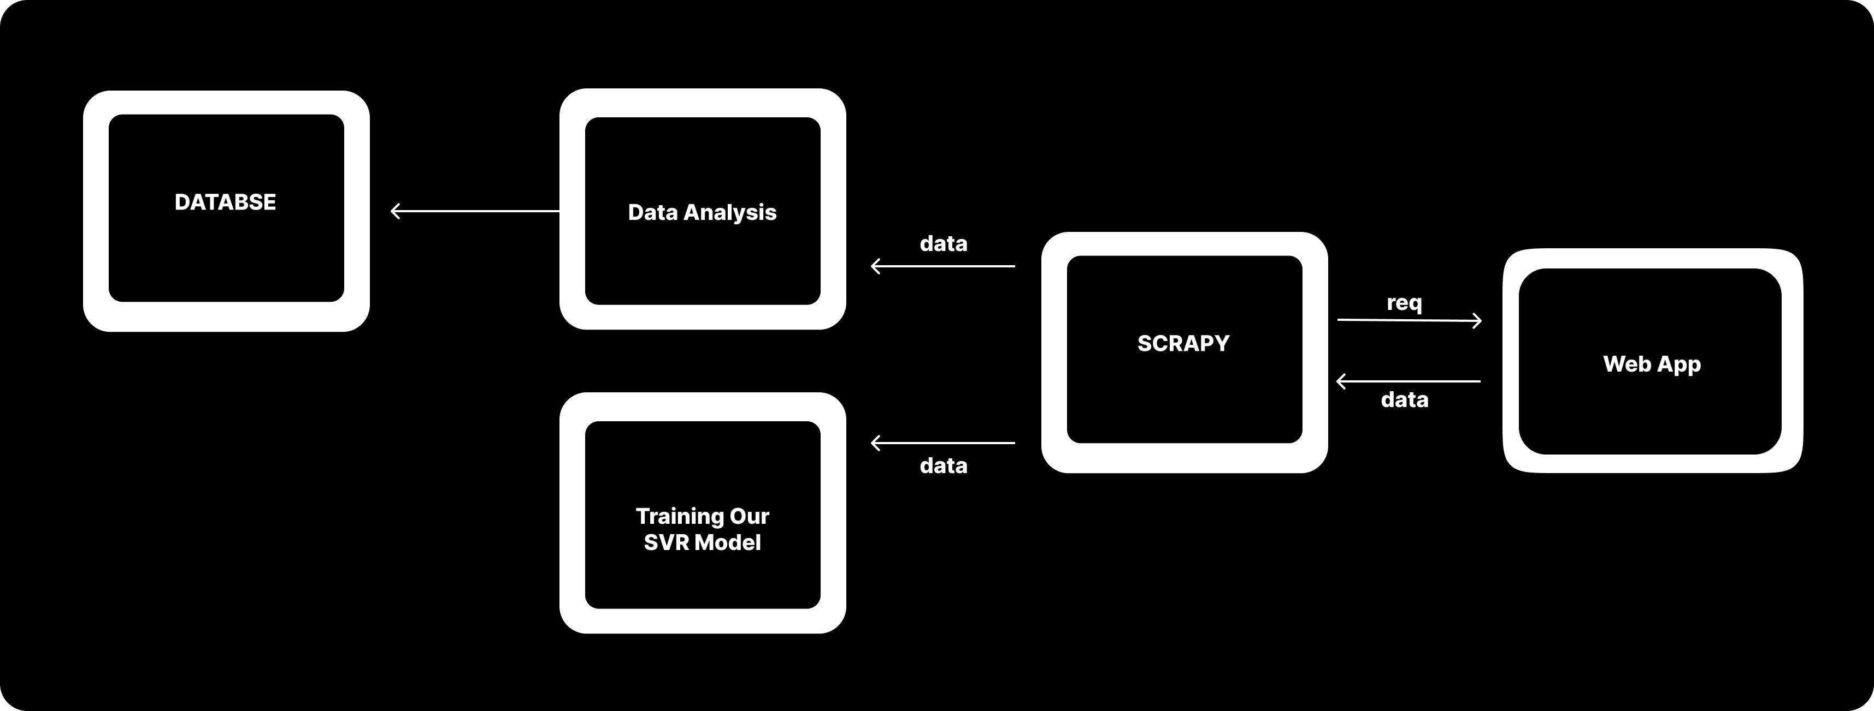
Methodology :

Slide 10
Web Scraping
Web scraping is the automated extraction of data from websites.
Scrapy is an open-source web crawling and web scraping framework written in Python.
Features: Provides tools and libraries for building web spiders to navigate websites, extract data, and store it.
Key Components: Spiders, selectors, pipelines, middleware, and settings.

Slide 11
How Scrapy Works:
Creating a Spider: Define a Python class that specifies how to scrape a particular website.
Defining Start URLs: Specify one or more initial URLs as entry points for the spider.
Sending Requests: Send HTTP requests to web pages and fetch HTML responses.
Parsing HTML Responses: Extract data using selectors to identify specific elements or attributes within the HTML content.
Extracting Data: Use selectors to extract desired data such as text, links, or images.
Storing Data: Save extracted data in various formats like CSV, JSON, or databases using pipelines.
Following Links: Navigate through multiple pages by following links found within the HTML content.
Handling Errors: Implement error handling logic to manage issues like HTTP errors, timeouts, or connectivity problems.
Running the Spider: Execute the spider using the Scrapy command-line interface or programmatically within a Python script.

Slide 12
Data Analysis:
Data analysis involves examining, cleaning, transforming, and modeling data to derive insights and make informed decisions.
Tools and Libraries: Python, Pandas, NumPy, Matplotlib.
Steps involved :
Data Cleaning: Remove duplicates, handle missing values, and format data for analysis.
Exploratory Data Analysis (EDA): Analyze data distributions, correlations, and trends using statistical measures and visualizations.
Feature Engineering: Create new features or transform existing ones to improve model performance.
Data Visualization: Use charts, plots, and graphs to visualize data patterns and relationships.

Slide 13
Storing Analyzed Data into MongoDB Database:
MongoDB is a NoSQL database that provides flexibility and scalability for storing and querying unstructured or semi-structured data.
Steps:
Connecting to MongoDB: Establish a connection to the MongoDB database using a Python library like PyMongo.
Creating a Database and Collection: Define a database and collection to store the analyzed data.
Converting Data to JSON: Convert the analyzed data into JSON format, suitable for storage in MongoDB documents.
Inserting Data: Insert the JSON-formatted data into the MongoDB collection using the insert_one() or insert_many() method.
Querying Data: Perform queries to retrieve and analyze data stored in MongoDB collections.
Updating and Deleting Data: Modify or remove documents in the MongoDB collection as needed.

Slide 14
SVR Model Training:
Support Vector Regression (SVR) is a machine learning algorithm used for regression tasks.
Steps :
Data Preparation: Split the data into training and testing sets.
Feature Scaling: Normalize or standardize the features to ensure consistency in model training.
Model Training: Use the SVR algorithm to fit the training data and learn the underlying patterns.
Model Evaluation: Assess model performance using metrics such as Mean Absolute Error (MAE), Mean Squared Error (MSE), or R-squared.
Prediction: Apply the trained SVR model to make predictions on new data.

Slide 15
THANK YOU

